Slide 1
Getting Started with Neural Networks
Cameron Evangelista, Dale Gao

Slide 2
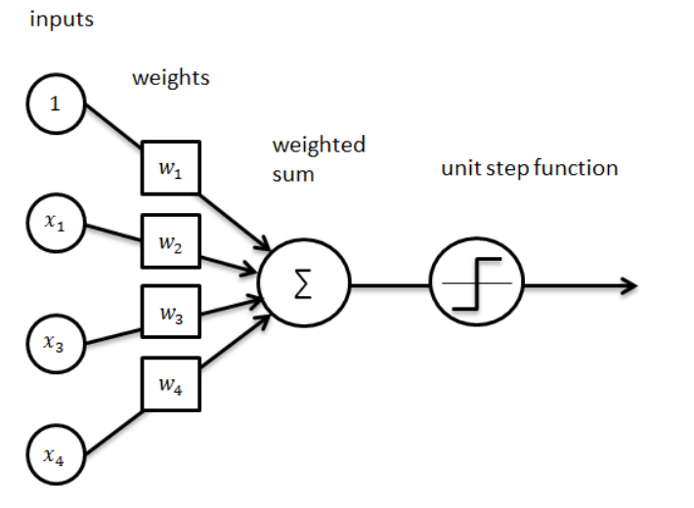
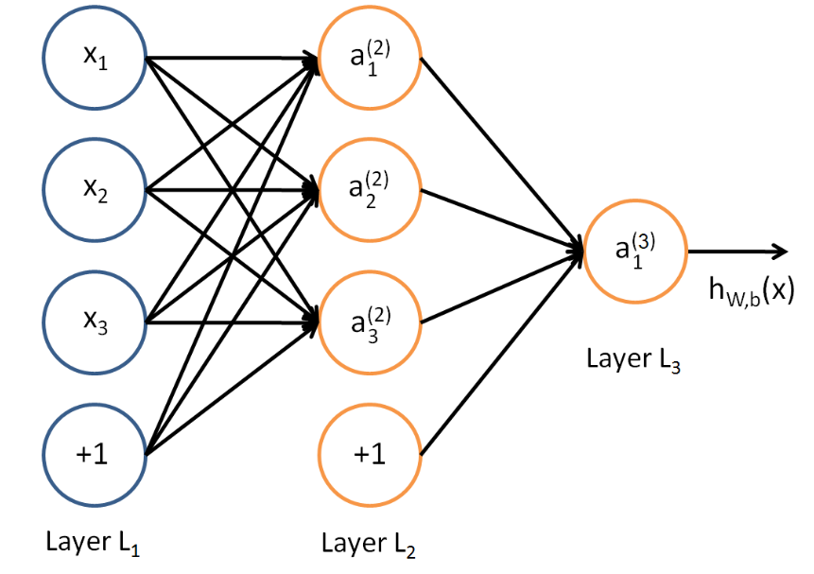
Core components of neural networks
Layers: contains multiple codes (including bias node)
Nodes: weights, activation functions
Input data: in the form of a tensor
Targets: to be compared with model prediction
Loss function: used in optimization
Optimizer: used to train the weights

Slide 3
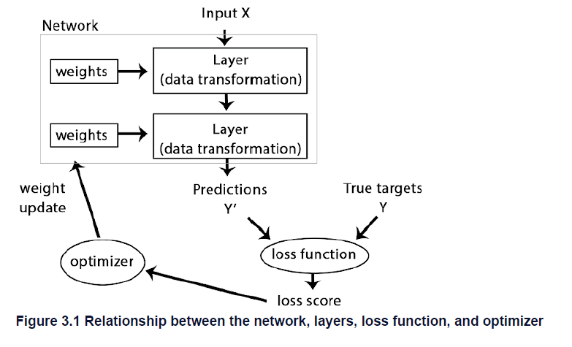
How these components form an Neural Network
Model: NN with multiple layers
Data: X (input), Y (target)
Optimization: loss function and optimizer
Backpropagation Optimization Process
Compute initial weight estimates
Generate predictions
Compare predictions against true targets
Compute loss score
Optimize loss score by updating weights
Repeat steps 2-5 until weights converge

Slide 4
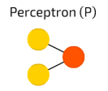
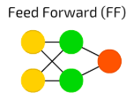
Types of Neural Networks
The simplest and oldest NN there is
Takes two inputs
Applies activation function
Sends it to the output layer
Follows certain rules such as
All nodes are connected
Activation flows from input to output layer without back loops
There is one layer between input and output layer (hidden layer)
In most cases, this network is trained using a backpropagation algorithm.
https://towardsdatascience.com/the-mostly-complete-chart-of-neural-networks-explained-3fb6f2367464

Slide 5
Neural Network with Keras
multiclass classification

Slide 6
Reference
Deep Learning with R
Everything you need to know about Neural Networks and Backpropagation — Machine Learning Easy and Fun; access:https://towardsdatascience.com/everything-you-need-to-know-about-neural-networks-and-backpropagation-machine-learning-made-easy-e5285bc2be3a
The Mostly Complete Chart of Neural Networks https://towardsdatascience.com/the-mostly-complete-chart-of-neural-networks-explained-3fb6f2367464

